Slide 1

CSE-213
(Data Structure)
Lecture on
Linear and Binary Searching

Slide 2
Searching
Searching refers to the operation of finding the location LOC of ITEM in Data, or printing some message that ITEM does not appear there.
The search is said to be successful if ITEM does appear in Data and unsuccessful otherwise.
There are many different searching algorithms. The algorithm that one chooses generally depends on the way the information is DATA is organized.
A simple searching algorithm: Linear Search Algorithm
The well known algorithm: Binary search Algorithm

Slide 3
Linear Search Algorithm
Suppose DATA is a linear array with n elements. Given no other information about DATA.
Simple way to search for a given ITEM in DATA is to compare ITEM with each element of DATA one by one.
Suppose we want to know whether Jhon appears in the array or not.
Again, Suppose, we want to know wheter Moon appears in the array or not.
Adams
Charlie
Rasha
Moon
Rock
Smith
Adams
Charlie
Rasha
Moon
Rock
Smith
Jhon
Adams
Charlie
Rasha
Moon
Rock
Smith
Moon

Slide 4
Linear Search Algorithm: Example
Notes:
Here DATA is a linear array with N elements, and ITEN is a given item of information. This algorithm finds the location LOC of item in DATA, or sets LOC:=0 if the search is unsuccessful.

Slide 5
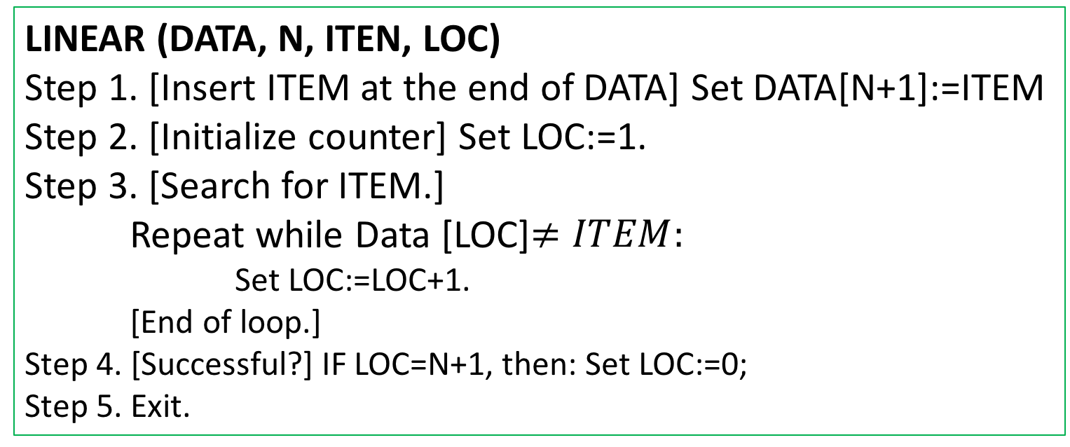
Searching: Linear Search Algorithm
LINEAR (DATA, N, ITEN, LOC)
Step 1. [Insert ITEM at the end of DATA] Set DATA[N+1]:=ITEM
Step 2. [Initialize counter] Set LOC:=1.
Step 3. [Search for ITEM.]
Repeat while Data [LOC]$≠ITEM:$
Set LOC:=LOC+1.
[End of loop.]
Step 4. [Successful?] IF LOC=N+1, then: Set LOC:=0;
Step 5. Exit.

Slide 6
Linear Search Algorithm: Complexity
The complexity of this algorithm is measured by the number f(n) of comparison required to find ITEM where DATA contains n elements.
Two important cases to consider are:
The average case, and
The worst case
The worst case occurs when one must search through the entire array DATA, when ITEM does not appear in DATA.
Algorithm Requires f(n)= n+1 comparison.
Thus, in the worst case, the running time is proportional to n
Notes:
Here DATA is a linear array with N elements, and ITEN is a given item of information. This algorithm finds the location LOC of item in DATA, or sets LOC:=0 if the search is unsuccessful.

Slide 7
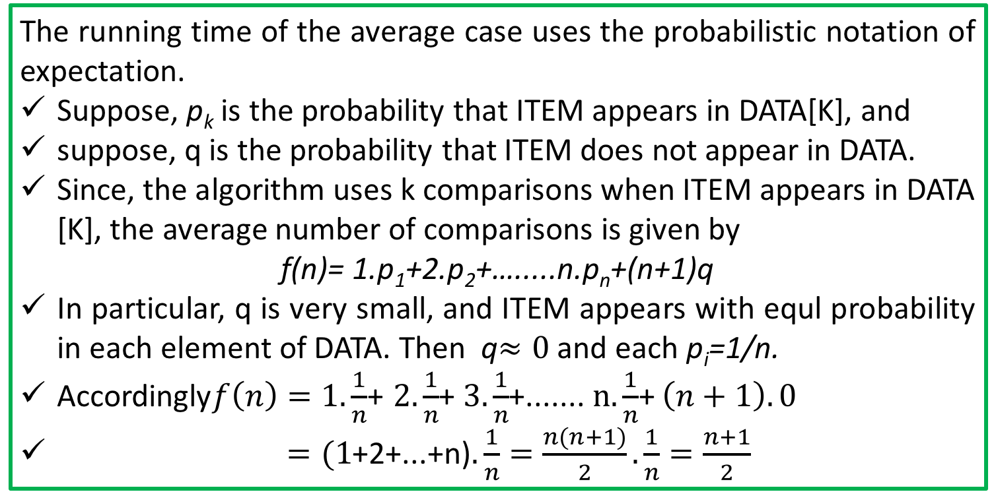
Linear Search Algorithm: Complexity
The complexity of this algorithm is measured by the number f(n) of comparison required to find ITEM where DATA contains n elements.
Two important cases to consider are:
The average case, and
The worst case
The running time of the average case uses the probabilistic notation of expectation.
Suppose, p_{k} is the probability that ITEM appears in DATA[K], and
suppose, q is the probability that ITEM does not appear in DATA.
Since, the algorithm uses k comparisons when ITEM appears in DATA [K], the average number of comparisons is given by
f(n)= 1.p₁+2.p₂+….....n.p_{n}+(n+1)q
In particular, q is very small, and ITEM appears with equl probability in each element of DATA. Then q$≈0$ and each p_{i}=1/n.
Accordingly$f\left(n\right)=1.\frac{1}{n}$+ $2.\frac{1}{n}$+ $3.\frac{1}{n}$+....... $n.\frac{1}{n}$+ $\left(n+1\right).0$
$=(1$+2+...+n)$.\frac{1}{n}=\frac{n(n+1)}{2}.\frac{1}{n}=\frac{n+1}{2}$
Notes:
That is, in this special case, the average number of comparison required to find the location of ITEM is approximately equal to half of the number of elements in the array

Slide 8
Binary Search:
Suppose DATA is an array which is sorted in INCREASING ORDER, or equivalently, alphabetically.
Then, Binary Search algorithm is an extremely efficient searching algorithm to find the location LOC of a given ITEM of information in DATA.
Binary search algorithm applied to array DATA works as follows:
DATA[BEG], DATA[BEG+1], DATA[BEG+2],…....., DATA[END]
This algorithm compares ITEM with the middle element DATA [MID] of the segment, where MID is obtained by
MID=INT((BEG+END)/2)
If DATA[MID]=ITEM, then the search is SUCCESSFUL.
We set LOC:=MID
....Otherwise a new segment of DATA is obtained.

Slide 9
Binary Search:
If ITEM < DATA[MID], then ITEM can appear only in the left half of the segment:
DATA[BEG], DATA[BEG+1], ….DATA[MID-1]
So, we resent END:=MID-1 and begin searching again.
(b) If ITEM> DATA[MID], then ITEM appear only in the right half of the segment:
DATA[MID+1], DATA[MID+2],...........DATA[END]
So, we reset BEG:=MID+1 and begin searching.
Initially, we begin with entire array DATA, i.e. We begin wit BEG=1 and END=n, or more generally, with BEG=LB and END=UB.
If ITEM is not in DATA, then eventually we obtain
END< BEG
Which means the search is Unsuccessful
So, SET LOC:=NULL (OUT side of DATA indices)
Notes:
Here DATA is a linear array with N elements, and ITEN is a given item of information. This algorithm finds the location LOC of item in DATA, or sets LOC:=0 if the search is unsuccessful.

Slide 10
Binary Search: : Example
Searching the array below for the value 42:
index | 0 | 1 | 2 | 3 | 4 | 5 | 6 | 7 | 8 | 9 | 10 | 11 | 12 | 13 | 14 | 15 | 16
value | -4 | 2 | 7 | 10 | 15 | 20 | 22 | 25 | 30 | 36 | 42 | 50 | 56 | 68 | 85 | 92 | 103
min
mid
max
Notes:
Here DATA is a linear array with N elements, and ITEN is a given item of information. This algorithm finds the location LOC of item in DATA, or sets LOC:=0 if the search is unsuccessful.

Slide 11
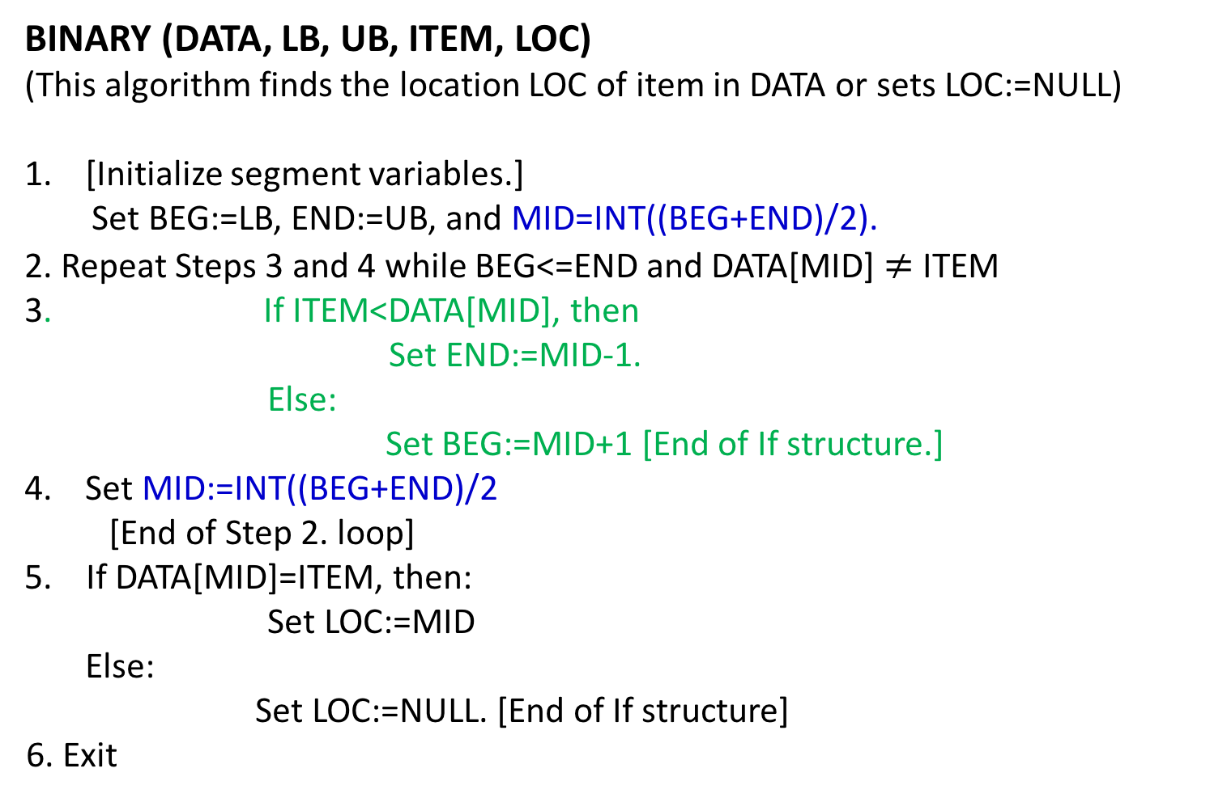
Binary Search: Algorithm
BINARY (DATA, LB, UB, ITEM, LOC)
(This algorithm finds the location LOC of item in DATA or sets LOC:=NULL)
[Initialize segment variables.]
Set BEG:=LB, END:=UB, and MID=INT((BEG+END)/2).
2. Repeat Steps 3 and 4 while BEG<=END and DATA[MID] $≠$ ITEM
3. If ITEM<DATA[MID], then
Set END:=MID-1.
Else:
Set BEG:=MID+1 [End of If structure.]
Set MID:=INT((BEG+END)/2
[End of Step 2. loop]
5. If DATA[MID]=ITEM, then:
Set LOC:=MID
Else:
Set LOC:=NULL. [End of If structure]
6. Exit
Notes:
Here DATA is a linear array with N elements, and ITEN is a given item of information. This algorithm finds the location LOC of item in DATA, or sets LOC:=0 if the search is unsuccessful.

Slide 12
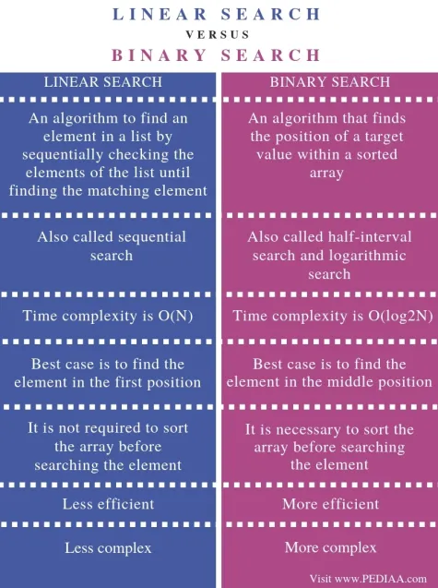
Notes:
Here DATA is a linear array with N elements, and ITEN is a given item of information. This algorithm finds the location LOC of item in DATA, or sets LOC:=0 if the search is unsuccessful.

Slide 13

Binary Search: Limitations
Your Task
Notes:
Here DATA is a linear array with N elements, and ITEN is a given item of information. This algorithm finds the location LOC of item in DATA, or sets LOC:=0 if the search is unsuccessful.

